Slide 1


Department of Artificial Intelligence and Machine Learning
Smart Grid Management
Dr J M Gnanasekar
HOD AI&DS.
Samyuktha S(221801043)
Vaishnavi M(221801058)

Slide 2
Problem Statement and Motivation
Build an optimization algorithm for smart grid management that balances energy supply and demand, integrates renewable energy sources, and minimizes energy losses.
It enhances the following:
1.Environmental sustainability
2.Economical efficiency
3.Technological advancements
4.Grid reliability
5.Consumer empowerment

Slide 3
Objectives
The objective is to develop and implement a grid management approach that enhances energy efficiency, reduces operational costs, and supports environmental sustainability. It aims to integrate advanced technologies such as real-time monitoring, renewable energy sources while implementing cost-effective solutions like low-cost sensors and blockchain-based energy trading. By optimizing energy distribution, minimizing waste, and empowering consumers with data-driven insights, the system seeks to create an eco-friendly grid that meets current energy demands and adapts to future challenges.

Slide 4
Abstract
The Sustainable and Cost-effective Smart Grid Management System aims to revolutionize energy management by integrating advanced technologies to enhance efficiency and sustainability while minimizing costs. This system leverages real-time monitoring through low-cost sensors, incorporates renewable energy sources, and utilizes blockchain technology for peer-to-peer energy trading. By implementing automated demand response and dynamic pricing strategies, it optimizes energy distribution and consumption. The approach not only reduces operational expenses and energy waste but also empowers consumers with actionable insights to make informed decisions. Ultimately, the system seeks to establish a resilient, environmentally friendly grid that adapts to evolving energy needs and promotes long-term sustainability.

Slide 5
Introduction and Overview of the Project.
The transition towards a sustainable energy future is the development of smart grid management systems that balance efficiency, cost-effectiveness, and environmental impact. Traditional grid systems often face challenges such as high operational costs, energy waste, and limited integration of renewable sources. To address these issues, an innovative approach that combines advanced technologies and cost-efficient solutions to optimize grid performance is proposed.
It utilizes low-cost sensors for real-time monitoring of energy usage and grid conditions, ensuring accurate data collection and analysis. Renewable energy sources, such as solar panels, are incorporated to reduce reliance on fossil fuels and lower operational costs. Blockchain technology facilitates peer-to-peer energy trading, allowing consumers to buy and sell energy directly, thus enhancing grid efficiency. Automated demand response and dynamic pricing strategies further optimize energy distribution and consumption.

Slide 6
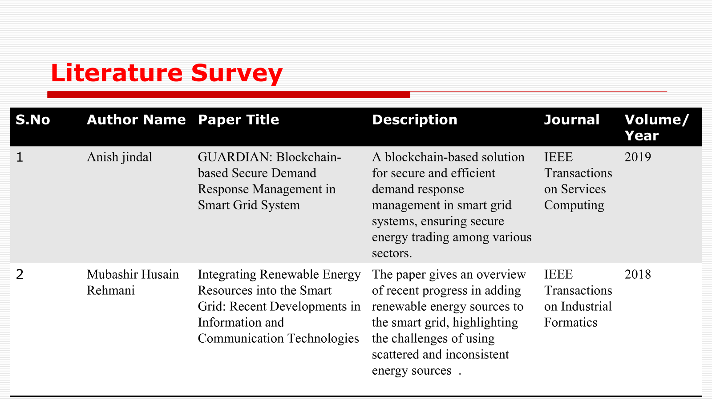

Slide 7
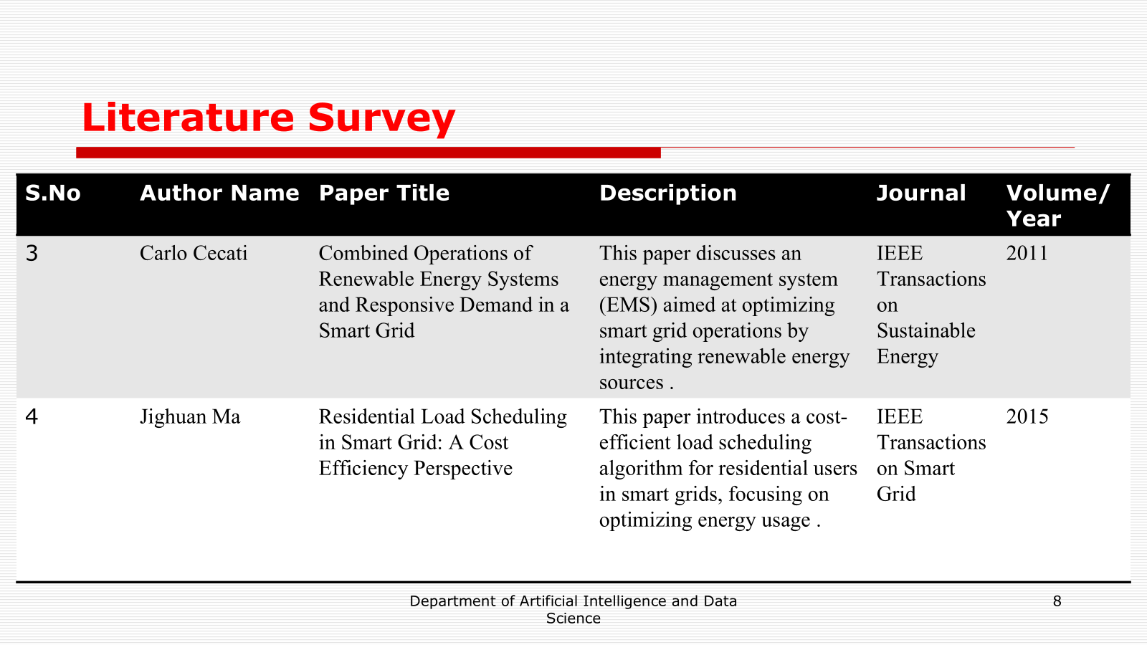
Literature Survey
S.No | Author Name | Paper Title | Description | Journal | Volume/ Year
3 | Carlo Cecati | Combined Operations of Renewable Energy Systems and Responsive Demand in a Smart Grid | This paper discusses an energy management system (EMS) aimed at optimizing smart grid operations by integrating renewable energy sources . | IEEE Transactions on Sustainable Energy | 2011
4 | Jighuan Ma | Residential Load Scheduling in Smart Grid: A Cost Efficiency Perspective | This paper introduces a cost-efficient load scheduling algorithm for residential users in smart grids, focusing on optimizing energy usage . | IEEE Transactions on Smart Grid | 2015

Slide 8
Existing Sytem
1.Traditional Grid Infrastructure: Many existing grids rely on legacy systems with centralized control, which are often outdated and lack the capabilities for real-time monitoring and automation.
2.Renewable Energy Integration : Some grids incorporate renewable energy sources like solar and wind to reduce reliance on fossil fuels and promote sustainability.
3.Consumer Engagement : Current systems provide limited interaction between consumers and the grid, typically offering basic usage data and static pricing.
Linear Programming (Optimization):

Slide 9
Drawback of Existing System
High Operational Costs : Legacy infrastructure requires expensive maintenance and frequent upgrades, increasing overall operational costs.
Limited Integration of Renewable: Renewable energy sources like solar and wind are variable and can cause inconsistencies in energy supply
Insufficient Real-time Monitoring and Control: Many systems do not provide real-time data on energy usage and grid conditions, leading to slower response and decision-making.

Slide 10
Proposed System
Integration of Renewable Energy Sources:Deploy renewable energy technologies such as solar panels and wind turbines.Implement energy storage solutions to manage intermittency and store excess energy.
Real-time Monitoring and Control:
Install low-cost sensors throughout the grid for continuous monitoring of energy usage and grid conditions.Develop a centralized monitoring system .
Blockchain-Based Energy Trading:Create a blockchain platform for secure, decentralized peer-to-peer energy trading.
Automation and Smart Technologies:Use dynamic pricing models to incentivize consumers to shift usage to off-peak times, improving grid efficiency.
Enhanced Consumer Engagement:Develop a mobile app that provides real-time data, dynamic pricing information, and personalized energy-saving tips.

Slide 11
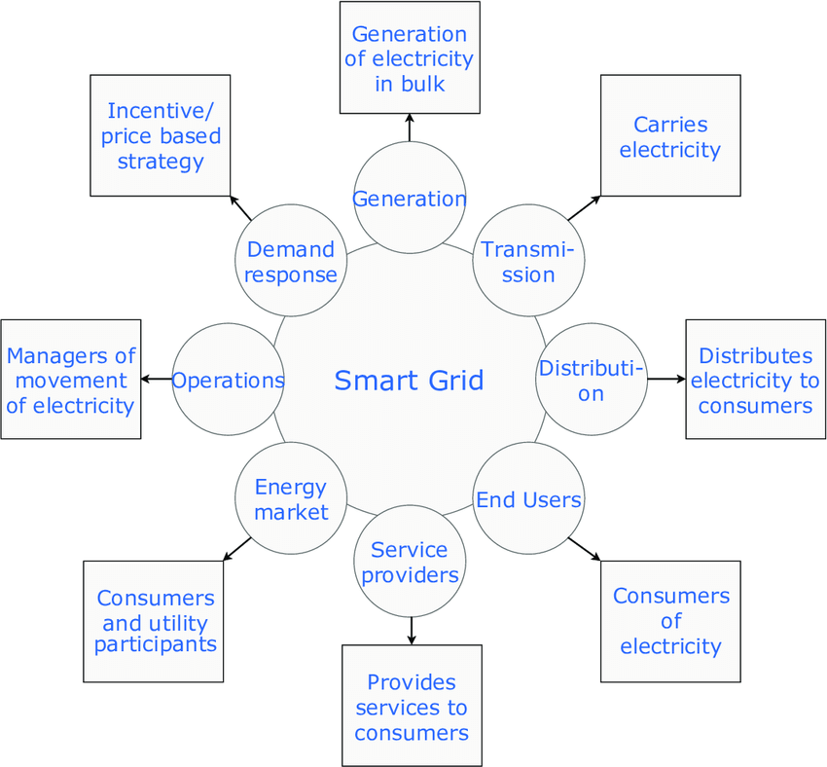
System Architecture

Slide 12
List of modules
Load forecasting module
Energy supply optimization module
Grid stability and security module
Cost optimization module
User energy management module

Slide 13
Load forecasting module
Purpose: Predicts future energy demand for efficient energy management.
Key Forecast Types:
Short-term (hours to days).
Medium-term (weeks to months).
Long-term (years).
Techniques Used:
Statistical models (time series, regression).
Machine learning (neural networks, decision trees).
Hybrid models combining multiple approaches.
Applications:
Grid stability and real-time operations.
Renewable energy integration.
Energy market trading and pricing.
Cost and resource optimization.

Slide 14
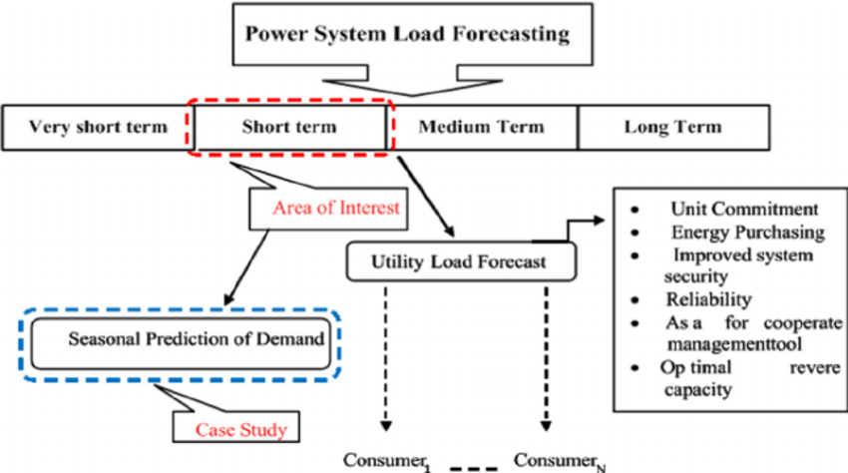
DATA FLOW DIAGRAM

Slide 15
Energy supply optimization module
Purpose: Ensures efficient energy production, distribution, and utilization while minimizing costs and waste.
Key Functions:
Balances energy supply with demand in real time.
Optimizes resource allocation (fossil fuels, renewables, etc.).
Reduces overproduction and underutilization of energy.
Techniques Used:
Linear programming and optimization algorithms.
Machine learning for predictive analytics.
Demand-side management strategies.
Applications:
Integration of renewable energy sources.
Cost-effective power generation and distribution.
Scheduling maintenance and reducing operational downtime.

Slide 16
Grid stability and security module
Purpose: Ensures reliable operation of power grids by maintaining balance between energy supply and demand.
Key Functions:
Monitors real-time grid performance and detects anomalies.
Manages load fluctuations and prevents blackouts.
Supports grid resilience against cyber and physical threats.
Techniques Used:
Real-time data analytics and monitoring systems.
Advanced control algorithms for frequency and voltage regulation.
Predictive models to anticipate and mitigate disruptions.
Cybersecurity frameworks to protect grid infrastructure.
Applications:
Mitigating risks of overloading and equipment failure.
Facilitating renewable energy integration and managing variability.

Slide 17
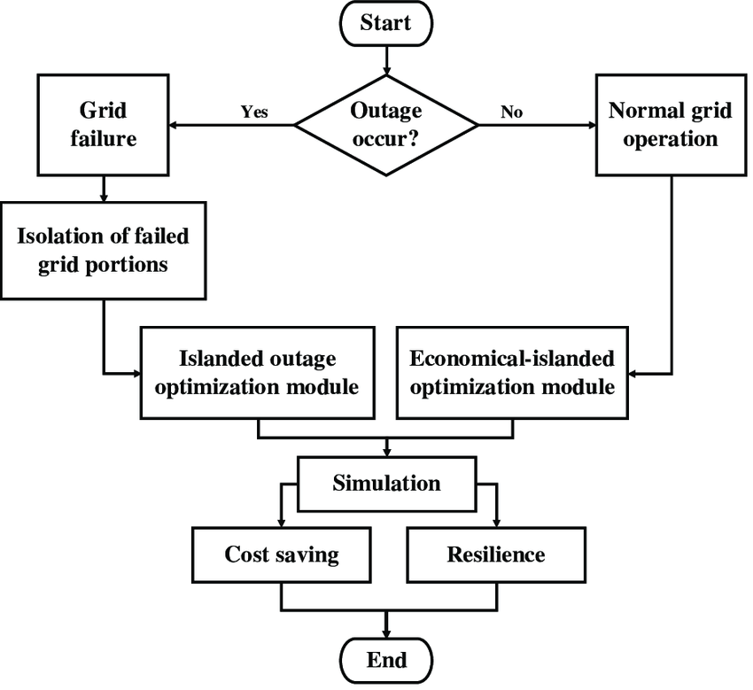
DATA FLOW DIAGRAM

Slide 18
COST OPTIMIZATION MODULE
Purpose: Minimizes operational costs in energy production, distribution, and consumption while maintaining efficiency and reliability.
Key Functions:
Identifies cost-saving opportunities in energy generation and resource allocation.
Reduces fuel and operational expenses through predictive maintenance.
Optimizes load scheduling and dispatch strategies.
Techniques Used:
Linear programming and cost minimization algorithms.
Machine learning for demand forecasting and resource optimization.
Real-time monitoring of energy usage patterns.
Applications:
Reducing energy production costs for utilities and industries.
Optimizing renewable energy utilization to lower dependency on fossil fuels.
Supporting dynamic pricing strategies in energy markets.

Slide 19
Algorithm
Step 1: Input Data Preparation
Collect historical electricity consumption data as a time series.
Ensure the data is clean, with:
A proper datetime column (datetime).
A corresponding column for electricity consumption (electricity_consumption).

Slide 20
Algorithm
Step 2: Define the Model
Use the Holt-Winters Exponential Smoothing model (statsmodels.tsa.holtwinters.ExponentialSmoothing) with the following settings:
Additive trend to capture linear changes in demand over time.
Additive seasonality to account for repeating patterns (e.g., daily variations).
Seasonal Periods set to

Slide 21
Algorithm
Step 3: Train the Model
Fit the model to the historical electricity consumption data (demand_data).
During training, the model computes:
The level (baseline demand).
The trend (rate of increase or decrease in demand).
The seasonal components (hourly or daily variations).

Slide 22
Algorithm
Step 4: Generate Predictions
Use the trained model to forecast future electricity demand for a specified number of time steps.
In the project, the forecast is generated for the same length as the historical data to simulate future demand.
Formula: The predictions are computed using the Holt-Winters equations:

Slide 23

Algorithm
lt​: Level (current smoothed demand).
btb_tbt​: Trend (rate of change in demand).
st−m+hs_{t-m+h}st−m+h​: Seasonal component for the forecasted period.

Slide 24
Algorithm
Step 5: Use Predictions in Optimization
The predicted demand (predicted_demand) is passed to the optimization algorithm to:
Determine the optimal energy supply.
Minimize energy cost and carbon footprint while meeting future demand.

Slide 25
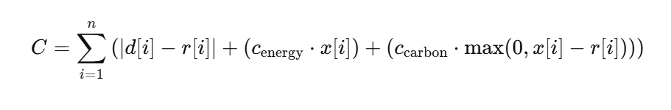
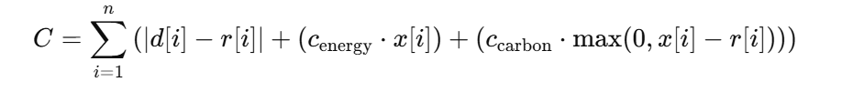
Equation
Total Cost:

Slide 26
Equation
Objective Function for Cost Prediction

Slide 27
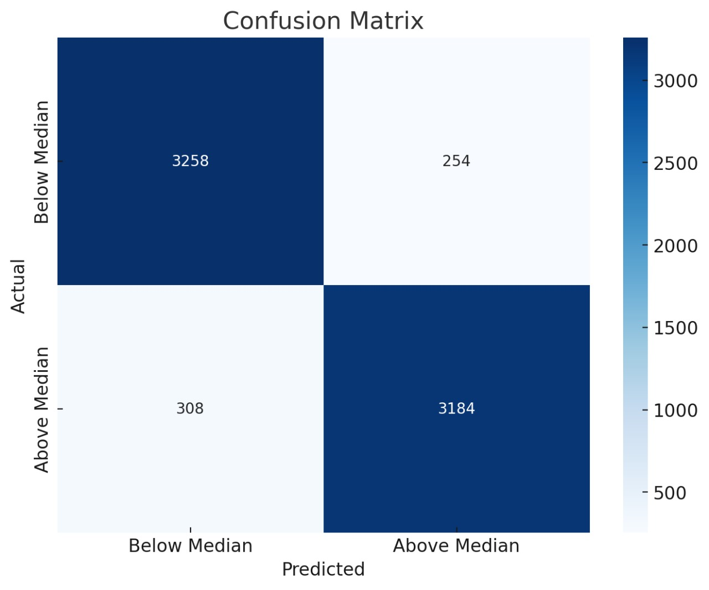
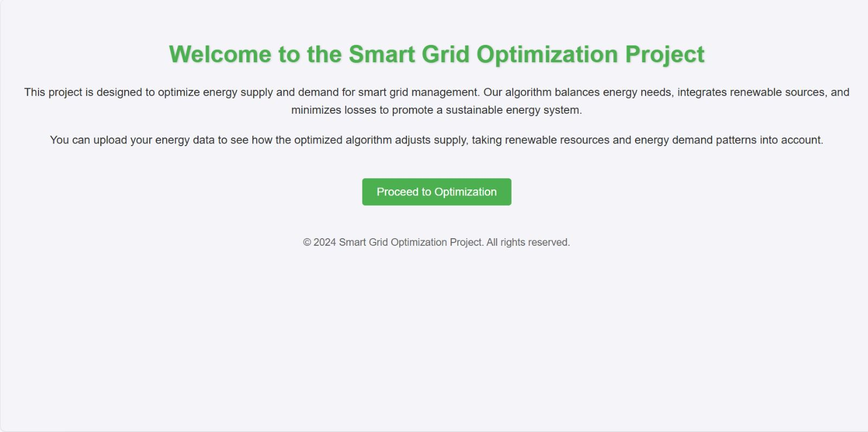
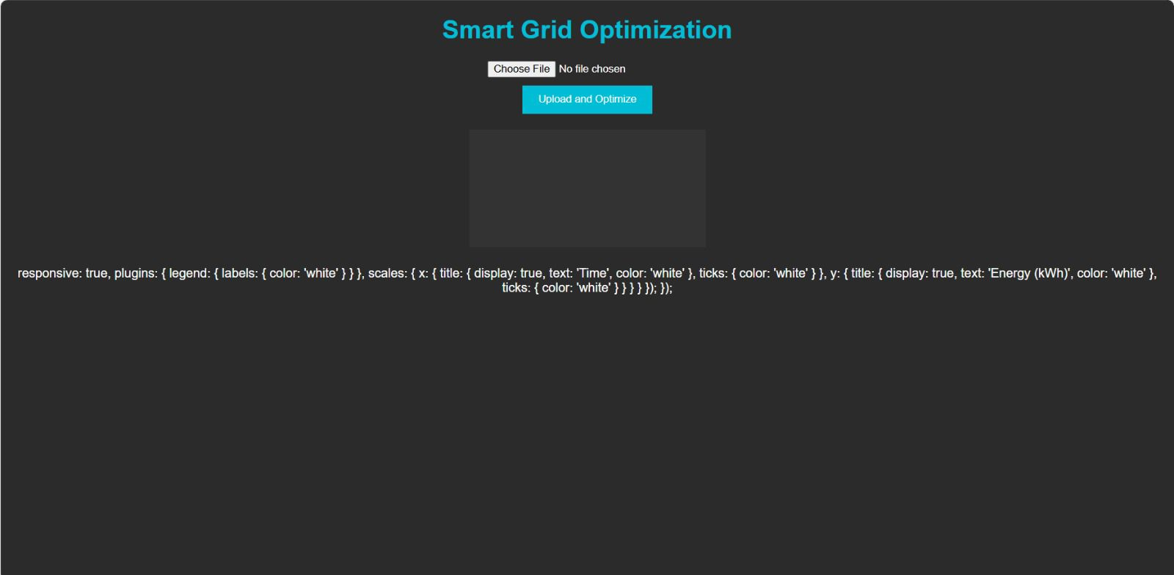
OUTPUT:

Slide 28
OUTPUT:

Slide 30
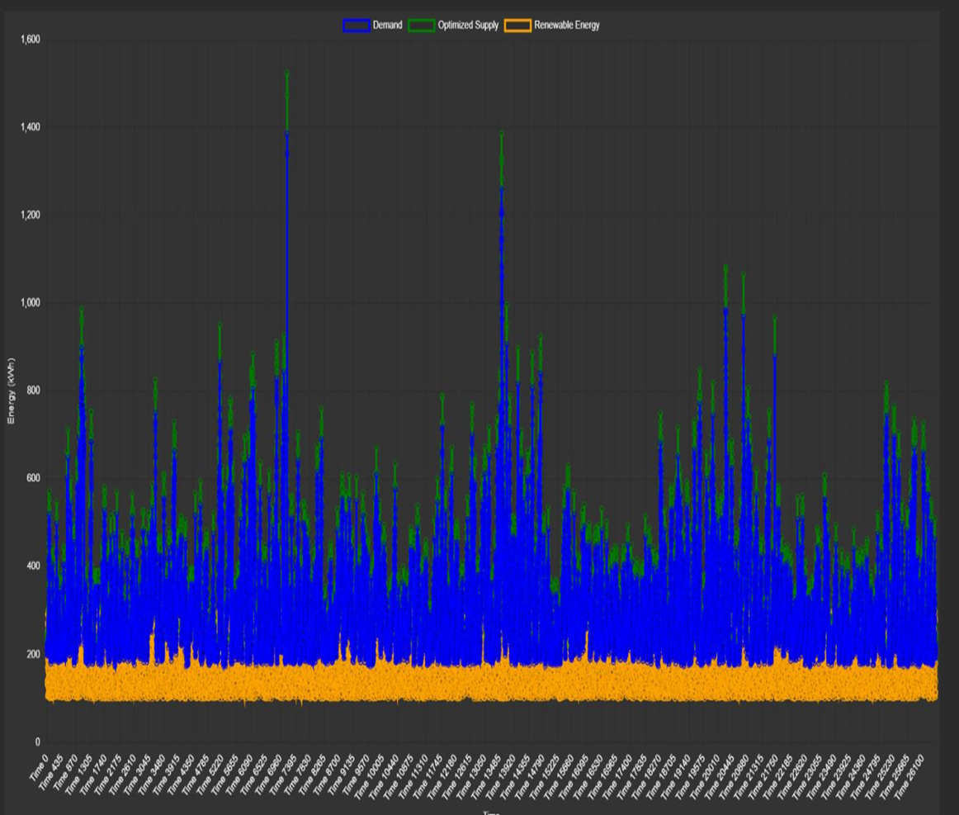

Slide 31
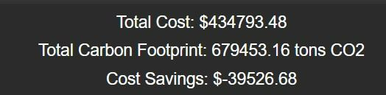

Slide 32
References.
"Smart Grid: Technology and Applications" by Janaka Ekanayake, Nick Jenkins, and Kithsiri L. Weerasinghe
"Renewable and Efficient Electric Power Systems" by Gilbert M. Masters
"Blockchain Technology for Smart Grids: A New Paradigm" by Michael M. C. S. De Souza
"A Review of Smart Grid Technology and its Applications" - IEEE Transactions on Smart Grid
"Blockchain-Based Smart Contracts for Energy Trading: A Review" - Renewable and Sustainable Energy Reviews

Slide 33
Thank You

